Slide 1
Japan and Korea
Strategic Charters
All Staff Meeting
October 21, 2015

Slide 2
Staying True to MDRT’s Core Values
January 2013 to Today: What We Accomplished
Staying True to MDRT’s Core Values
  Reaffirmed Mission
  Articulated First Principles to Guide Decision Making
Strategic Objectives
  Developed Charter Statements to Summarize Broad Strategic Plan Goals
  Visualized MDRT’s Value Proposition (Member Engagement Illustration)
  Integrated Member Segments
Chosen Focus
  Created Global Platforms

Slide 3
Staying True to MDRT’s Core Values
January 2013 to Today: What We Accomplished
Strategies Developed
  Developed Specific Strategies to Achieve Plan Goals
  Identified Core Countries on Which to Focus
  Creating Country Charters to Provide Roadmap for Increasing Member Engagement
  Relied on Work Streams to Provide Stakeholder Input
U.S. Charter
  Reviewed Output from Work Streams
  Articulated the U.S. Vision Statement
  Identified Six Focus Areas to Achieve the Vision
  Outlined Initiatives Within Focus Areas

Slide 4
Staying True to MDRT’s Core Values
January 2013 to Today: What We Accomplished
Japan and Korea Charters
  The Executive Committee, Staff and Hay Group Developed Charters for Japan and Korea
  These charters are the focus of today’s meeting

Slide 5
Staying True to MDRT’s Core Values
MDRT’s Mission
At the beginning of the strategic planning process, the Executive Committee spent considerable time identifying how MDRT carries out its mission and how members engage with it.
To be a valued, member-driven, international network of leading insurance and investment financial services professionals/advisors, who serve their clients by exemplary performance and the highest standards of ethics, knowledge, service and productivity.

Slide 6
Staying True to MDRT’s Core Values
First Principles
At the core of MDRT and the strategic plan is a set of Principles that unite members regardless of age, country of origin or gender. They provide a lens to review strategic decisions to ensure they are consistent with MDRT’s values.
First Principles
Organizational Independence | Steadfast adherence to MDRT’s best interests.
Highest Standard of Excellence | Offering the best to the most accomplished.
Value and Self-Worth to the Member | Providing personal and business development opportunities.
Member Connectivity | Sharing common experiences and unique insights
Ethical | Behaving professionally with the highest standards.
Decisions need not apply to all First Principles for approval.
However, if an opportunity violates even one Principle, it will be disqualified.

Slide 7
Strategic Objectives
Charter Statements
The Executive Committee identified five objectives for MDRT’s strategy. MDRT’s Charter states the strategic plan’s goals and provides guidance on how to execute MDRT’s vision.
Charter Statements
Promoting success and achievement
Enhancing brand excellence
Sharing innovative experiences
Connecting people and ideas
Growing global leaders

Slide 8
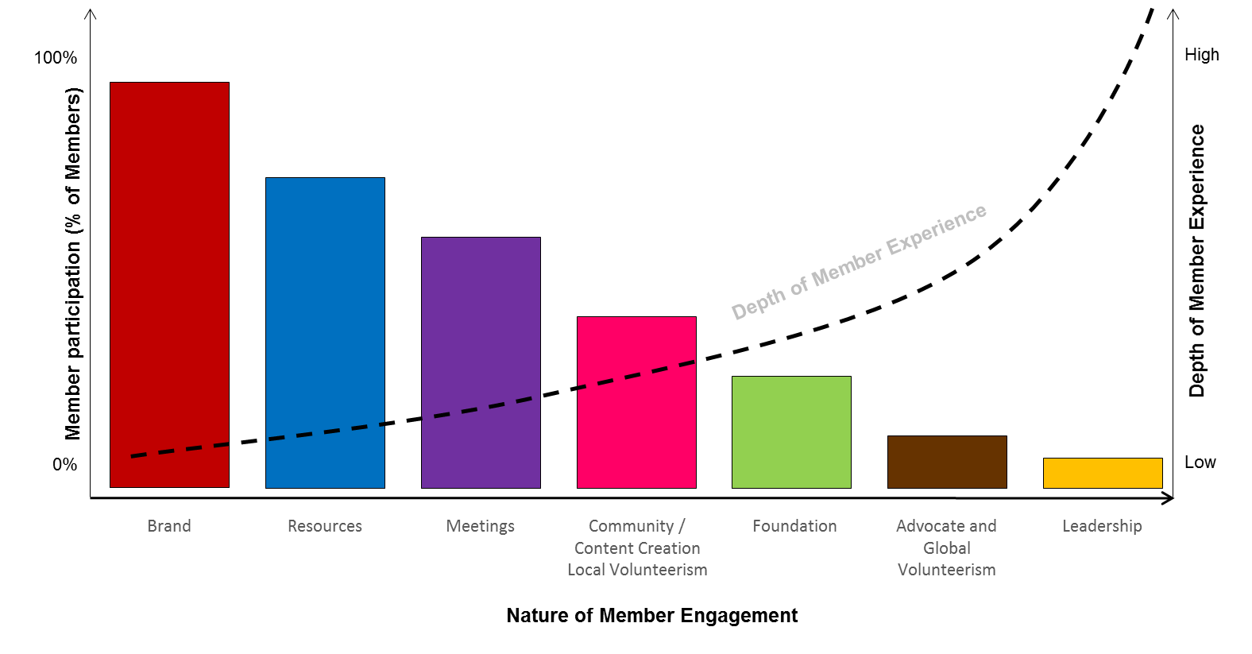
Strategic Objectives
Member Engagement Model
Created to visually demonstrate MDRT’s value proposition and the different ways members engage (participate) in MDRT.
The goal is to increase member engagement in all levers, both in terms of the number of participants and the depth of the member’s experience.
The Strategic Plan places particular emphasis on first two levers: Brand and Resources. These levers offer best opportunity to reach the greatest number of members—365 days a year.

Slide 9
Member Segments
Strategic Objectives
The Hay Group and staff developed the Member Segments before the strategic planning process began.
MDRT’s strategic intent is to design and deliver products and programs targeted to the special needs of the segments.
Sales Mastery
Business Development
Legacy Building and Succession Planning
Serve, engage and retain revenue-producing members, who are focused on growing production levels that enable them to maintain MDRT membership status.
Serve, engage, energize and retain revenue-producing members, who are focused on establishing and growing a business.
Serve, engage, energize and retain revenue-producing members, who are focused on maintaining a business, transitioning out of the industry and/or transferring out of their business.

Slide 10
Member Segments
Strategic Objectives
We have recently (September) added a fourth Member Segment: Pre-member.
This segment will focus on two groups of producers: those aspiring to be members, but don’t yet have the production; and former members who have not maintained production at the MDRT level.
We will focus on the U.S. first with this new member segment.
Pre-Member
Attract, serve, engage, energize and retain both aspiring and former members, who are focused on attaining and maintaining MDRT-level production (membership).

Slide 11
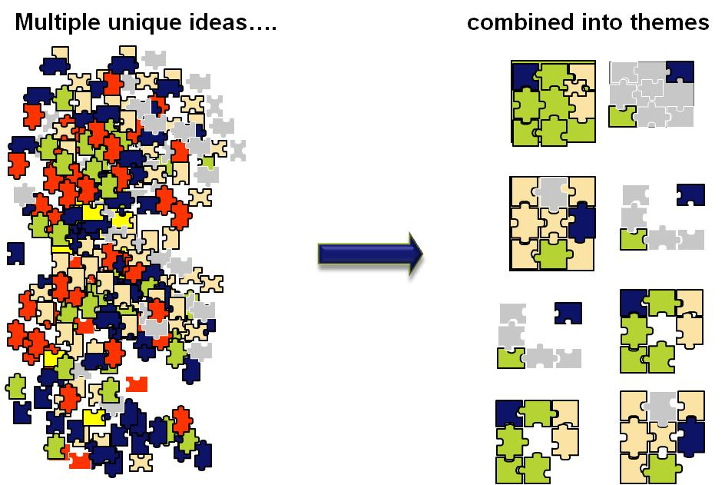
Chosen Focus
Global Platforms

Slide 12
Chosen Focus
Global Platforms
1. Transformative Productivity | Enabling members to achieve and surpass their personal and professional goals by capturing, curating and distributing relevant resources to become more productive.
2. Guided Development | Leveraging the coaching expertise of members and outside experts to assist members seeking to integrate further in the MDRT community.
3. Future Tense | Develop an informed understanding of emerging market trends to anticipate and meet the unique needs of MDRT members by investing in research and regularly communicating with allies.
4. Celebrating Achievement | Awareness, recognition, and celebration of member achievements that align with MDRT’s high standard of excellence.
5. Insights as an Asset | Gathering and reporting unique data from and about members that will be relevant to MDRT, members, external allies and others.
6. Stronger Together | Establish relationships with companies, associations and other external organizations to attract and retain members, add value to key allies and enhance organizational capabilities.
7. Network Connectivity | Providing opportunities for members to share ideas, connect on similar interests, and build community.

Slide 13
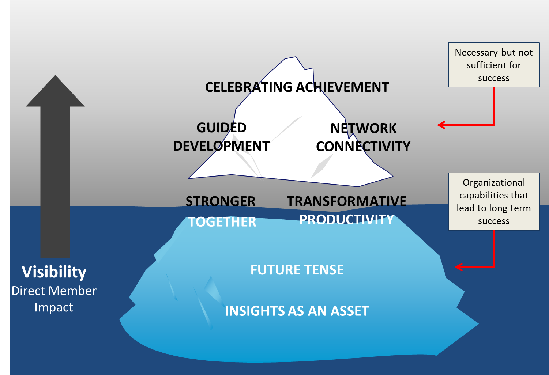
Chosen Focus
Platform Iceberg Graphic
Platforms above waterline have most visible member impact.
Platforms below waterline are foundational capabilities; they enable other Platforms.
All are essential to increasing member value.

Slide 14
Strategies Developed
Specific Plans
Specific strategies have been developed to help achieve the goals of the Strategic Plan and the global Platforms:
Technology (Mark, Jim and Wayne)
Content (Caroline, Pam and Katie) (Transformative Productivity Platform)
Branding (Jim and Don) (Celebrating Achievement)
Meetings (Brian, Ray, Tammy, Katie and Barb) (Meetings Lever)
Guided Development (Brian and Pam) (Guided Development Platform)

Slide 15
Identifying Core Countries
Strategies Developed
Analysis conducted on top 25 membership countries to identify areas where MDRT has a strong membership and significant growth prospects.
Ultimate goal of country analysis: Ensure MDRT effectively develops and fairly allocates resources to its diverse membership.

Slide 16
Identifying Core Countries
Strategies Developed
Narrowed down to three core countries: United States, Japan and Korea
  Charters for MDRT’s core countries developed based on membership trends and other findings.
  Each Charter articulates our plan for further increasing member engagement in a particular country.
Analysis also identified emerging countries:
  Mexico, China (via Hong Kong, Taiwan) and Southeast Asia.
  Focus is on developing and extending growth in these regions.

Slide 17
Strategies Developed
Developing Country Charters
MDRT leadership, staff and the Hay Group participated in several interrelated initiatives (Work Streams) to develop specific Country Charters within the Strategic Plan.
Each Charter provides a roadmap for implementing the Strategic Plan in that particular country.
The U.S. Charter was developed first and is being implemented.
The Charters are based on data and input from staff, various segments of membership and key allies. The most significant contributions to the Charters were:

Slide 18




Strategies Developed
Stakeholder Input: Work Streams
Identification of seven Platforms, which are areas for adding value to members and stakeholders (allies, companies, etc.) (Staff: Pam and Katie).
Innovation
(Mark Hanna)
Strategic Relations
(Caroline Banks)
Input from strategic company allies
(Staff: Eryn and Patti).
Member Insights
(Brian Heckert)
Surveys of current and former members on a wide range of topics (Staff: Tom and Vickie).
The output of other work streams was compiled to develop draft charters unique to Japanese and Korean memberships for Ex. Comm. to review/approve. (Ex. Staff, Hay Group).
Japan and Korea Charters
(Ex. Comm.)

Slide 19
Strategies Developed
The “Kill List”
Executive Staff worked with their staffs to develop a list of initiatives to eliminate.
Needed to look at what fit with the new strategic direction and what did not.
Concerns about adding too much to our plates.
The Executive Staff recommended several items for elimination.
Presented to the Executive Committee in December 2014 and March 2015.
We are working on eliminating those initiatives this year.
Anticipate another round of “kill list” initiatives in 2016.
Make a list of such initiatives, discuss with manager/director.
Need to focus on the right things!

Slide 20
Japan and Korea Charters

Slide 21
Staying True to MDRT’s Core Values
What We Accomplished re: Japan and Korea
Japan and Korea Charters
  Assessed Markets (Industry and Economies)
  Reviewed Results from Member and Company Surveys and Focus Groups
  Clarified Member and Company Value Drivers
  Discussed Relevant Member Segments
    Both Countries: Sales Mastery and Business Development
    Japan: Succession/Legacy Planning – need more information
  Uncovered Unique Areas of Interest
    Japan: Global Connectivity
    Korea: Leveraging Technology
  Discussed Ways to Involve the Chapters in Each Country
  Identified Five Focus Areas to Achieve the Vision
    Japan: Allies, Brand, Communities, Content
    Korea: Allies, Brand, Content, Technology
  Outlined Initiatives Within Focus Areas

Slide 22
Japan and Korea Charters
Achieving the Vision: Japan and Korea Focus Areas
The Focus Areas are how the strategic planning vision is realized, specifically and uniquely, in Japan and Korea.
They were created to help MDRT increase Japanese and Korean member engagement throughout career stages.
The Focus Areas are also Japanese and Korean manifestations of the Global Platforms.

Slide 23
Japan Charter

Slide 24
Japan Charter
Achieving the Vision: Japan Focus Areas
1. Branding/Marketing
Effectively communicate MDRT’s value proposition to key audiences to enhance the perception that MDRT is vital to a financial services professional’s success and to position MDRT members as the advisors of choice with clients.
Primary Platform: Celebrating Achievement

Slide 25
Branding/Marketing
Initiatives
High Priority
Hire a local PR firm to support client branding. 1ST QTR 2016
Develop corporate messaging. 3RD QTR 2016
  As a part of the Branding Toolbox, create client-facing video describing value of working with MDRT member to assist members with sharing MDRT’s value proposition with their clients. (Will develop U.S. toolbox and then determine what elements apply in Japan.) 4TH QTR 2017
Medium Priority
Involve chapter in developing a local branding strategy. 3RD QTR 2017

Slide 26
Branding/Marketing
Initiatives
Low Priority
Celebrate member milestones. 2ND QTR 2016
Celebrate 45th Anniversary of Chapter: Showcase the rich legacy of Japan. DONE
  MDRT Celebratory Pin with 45 Years
  MDRT Annual Meeting: Recognize past Japanese Chapter Presidents during the meeting on a milestone year (45th year is not culturally a milestone, look for other means)

Slide 27
Japan Charter
Achieving the Vision: Japan Focus Areas
2. Communities
Facilitate and encourage virtual and in-person communities throughout the year to bring MDRT’s special sense of self to various segments of membership, particularly those who desire to be locally and globally connected.
Primary Platform: Network Connectivity

Slide 28
Communities
Initiatives
Medium Priority
Celebrate group achievements by identifying groups (TOT, COT etc.) and creating an event or gathering to celebrate the achievement level they have reached. 2ND QTR 2017 (FIRST INVESTIGATE FEASIBILITY)
Consider (get more feedback on possibility of) specific networking activities at our meetings: reception, golf, baseball game and dinner (with language support). 4TH QTR 2017
Consider (get more feedback on possibility of) community activities: Foundation and members to come together to do a service project in Japan (open up for global volunteers to support). 4TH QTR 2017

Slide 29
Communities
Initiatives
Low Priority
Design a Connection Event linked to specific/relevant topics, including branding and Whole Person.
  Consider local member input on where to invest – telling them they have a $XXX K budget helps unleash creativity on what they value most and where best to invest resources (Mark Hanna did this during focus groups in Japan). 2ND QTR 2016
  Facilitate panel events/interviews for local members to interview thought leader/experts (also use for local content development). 4TH QTR 2016
  Explore development of study groups. 4TH QTR 2018
Leverage technology to create virtual communities. 4TH QTR 2018

Slide 30
Japan Charter
Achieving the Vision: Japan Focus Areas
3. Allies
Work closely with key allies to address our shared concerns, provide added value and grow mutually beneficial relationships.
Primary Platform: Stronger Together

Slide 31
Allies
Initiatives
High Priority
Organize an annual USA/Korea/Japan Leadership Summit to align understanding and execution of organizational strategies and goals. Include a track for chapter staff. 1ST QTR 2016
Develop and deliver membership or productivity insights to companies (insights as an asset). 2ND QTR 2016
Develop and implement a strategy for targeted communications to MNCs and the domestic career companies. 2ND QTR 2016
  Establish strong account management approach to build relationships with key allies.
  Communicate MDRT's strategy to company representatives both in person and using different media.
Develop and promote the Mentoring Program with an emphasis on Motivation and Whole Person. 4TH QTR 2016
  Where operationally and economically feasible, provide real time data (like Fitbit; how well are you doing, share trend data to motivate) 4TH QTR 2016

Slide 32
Allies
Initiatives
Medium Priority
Establish a recognition and communications process for company contacts to better connect them to MDRT and the work that they do on members' behalf. 4th QTR 2016
Reexamine MDRT's translation and interpretation policies in light of new strategic focus on Japan. 1st QTR 2017
Low Priority
Share the personal growth concept, offer companies content to help teach personal growth. 2nd QTR 2017
  Difference between Japanese domestic and MNCs: Develop a more targeted WP concept for domestic companies (to reach COT, TOT Status) vs. MNC (more balanced life).

Slide 33
Allies
Initiatives
Low Priority
Provide speakers from outside of Japan to chapter and company club meetings; leverage technology to bring more “outsiders” to Japan. 2nd QTR 2017
  Create forums for authentic exchange of information.
Gather intelligence about and develop outreach efforts to support the needs of brokerage firms and their producers. 4th QTR 2017

Slide 34
Japan Charter
Achieving the Vision: Japan Focus Areas
4. Content
Make MDRT the “go to” for professional and personal development resources by providing relevant, high-quality, easily accessible content to financial services professionals throughout their careers.
Primary Platform: Transformative Productivity

Slide 35
Content
Initiatives
High Priority
Find new ways to develop relevant content.
  Develop specific content with respect to Inheritance Tax (not lobbying). TBD
  Hire freelance writers and engage SWAT or Micro-Committees (Identify content experts, create focus groups to develop content). 2nd QTR 2016
  Record seminars and workshops conducted by the Chapter and distribute to local membership. (TO RECORD IN) 3rd QTR 2016
  Work with Chapter’s RTT committee to enhance quality of local content (consider Japanese edition of RTT. 3rd QTR 2016
  Target delivery of content to raise the awareness on what exists. Deliver customized content in targeted, innovative ways. SIMPLE: 4th QTR 2016
  Make relevant content readily available and easily accessible. Leverage “My MDRT” portal to suggest content based on member preferences. 4th QTR 2016
Make relevant communication available in Japanese. ONGOING

Slide 36
Content
Initiatives
High Priority
Focus content creation on Sales Mastery and Business Development member segments. 1st QTR 2016
Develop and implement content strategy relevant to the Sales Mastery and Business Development segments. Leverage Whole Person content. 3rd QTR 2016
Medium Priority
Develop videos with Western members/thought leaders that can be provided to members. 4th QTR 2016
Reposition members in Japan: They are leaders, they have a rich legacy and a lot to share: Create greater ownership for content creation. Doing this will require us to engage authentically with local member leaders. Collect and rank top ideas before developing content. 4th QTR 2017

Slide 37
Content
Initiatives
Low Priority
Identify content experts/contributors members. ONGOING
Develop a systematic approach to poll what’s most relevant to members (understand interest and areas of expertise). 2nd QTR 2017
Develop content for Company Club sessions (as relevant). 4th QTR 2018
Share Japanese success stories or create content on specific topics for other global members. (Doing through RTT profiles; enhance through Content Strategy.) 4th QTR 2018

Slide 38
Korea Charter

Slide 39
Korea Charter
Achieving the Vision: Korea Focus Areas
1. Branding/Marketing
Effectively communicate MDRT’s value proposition to key audiences to enhance the perception that MDRT is vital to a financial services professional’s success and to position MDRT members as the advisors of choice with clients.
Primary Platform: Celebrating Achievement

Slide 40
Branding/Marketing
Initiatives
High Priority
Hire a local PR firm to support client branding. 1ST QTR 2016
Assist members in better branding with clients:
  Offer tools to members to better position themselves with clients (develop Branding Toolbox in the future—emphasis on Whole Person). 4th QTR 2017
Tighten ethics process and Insignia Brand. 1st QTR 2017
  Marketing and Communications: Discussed with MCC leadership in 2015 and ongoing. Goal to have a reporting/monitoring process in place to deliver cases to Ethics Committee and insignia violations to Membership Committee.
  IT: Since the new Aptify system will automate the management of the Ethics process, and enhanced reporting will come from that system, these will be dependent on the Aptify Installation.

Slide 41
Branding/Marketing
Initiatives
Medium Priority
Involve Chapter in developing a local, consumer branding strategy. 3rd QTR 2017
Assist members in better branding with clients: Create customer-facing video describing value of working with MDRT member. 2nd QTR 2018
Low Priority
Celebrate member milestones. 2nd QTR 2016

Slide 42
Korea Charter
Achieving the Vision: Korea Focus Areas
2. Allies
Work closely with key allies to address our shared concerns, provide added value and grow mutually beneficial relationships.
Primary Platform: Stronger Together

Slide 43
Allies
Initiatives
High Priority
Organize an annual USA/Korea/Japan Leadership Summit to align understanding and execution of organizational strategies and goals. Include a track for chapter staff. 1ST QTR 2016
Develop and implement a strategy for targeting the three distinct company segments: foreign, domestic and GAs. 2nd QTR 2016
Reexamine MDRT's translation and interpretation policies in light of new strategic focus on Korea. 2nd QTR 2016
Develop and deliver membership or productivity insights to companies (insights as an asset). 4th QTR 2015
  Member Services: Done and ongoing. Currently providing “profile” reports to Global Markets for use with companies during HOP visits.
Hire staff at MDRT HQ who speaks Korean. DONE

Slide 44
Allies
Initiatives
Medium Priority
Establish a recognition and communications process for company contacts to better connect them to MDRT and the work that they do on members' behalf. 1st QTR 2016
  IT: Aptify will enable company-facing dashboard and membership/productivity information that they may find helpful. Design of these can be included in the project. 4th QTR 2017
Develop and promote the Mentoring Program for communicating best practices (sales 'know how'); supports agent training and development with knowledge/skills/experience to get agents to Life/COT/TOT status. 1st QTR 2016
Work with Chapter to support MDRT being official distributor of brand, logo, etc. 4th QTR 2015
Low Priority
Communicate MDRT's value proposition to company representatives both in person and using different media. 2nd QTR 2016
  Develop an effective intra company meetings format. 2nd QTR 2017
  Offer a more entrepreneurial path for the brokerage community by providing access to content, resources, best practices and thought leaders. 3rd QTR 2017

Slide 45
Korea Charter
Achieving the Vision: Korea Focus Areas
3. Content
Make MDRT the “go to” for professional and personal development resources by providing relevant, high-quality, easily accessible content to financial services professionals throughout their careers.
Primary Platform: Transformative Productivity

Slide 46
Content
Initiatives
High Priority
Develop and implement content strategy relevant to the Sales Mastery and Business Development segments. Leverage Whole Person content.
  Meeting Services: For 2016 Annual Meeting, developing a language specific track for Korea. Sales Mastery and Business Development are the segments for which the track is created. 2nd QTR 2016
Find new ways to develop relevant content.
  Record seminars and workshops conducted by the chapter and distribute to local membership. 3rd QTR 2016
  Make relevant communication available in local languages. 2nd QTR 2016
  Identify content experts, create focus groups to develop content. 4th QTR 2017
  Hire freelance writers and engage SWAT or micro-committees to develop content. 2nd QTR 2016
  Leverage intra company meetings to develop and distribute content. 4th QTR 2018 (for development). (Rely on Global Markets to coordinate distribution through company meetings.)

Slide 47
Content
Initiatives
Medium Priority
Deliver customized content both at and outside the meeting by leveraging technology.
  Meeting Services: Provide translated handouts. ONGOING
  Meeting Services: Provide language-specific program/registration books on Web site. ONGOING
  Meeting Services: Reviewing electronic signage that can handle various Korean characters. 2nd QTR 2016
  Meeting Services: Translate the meetings app. 2nd QTR 2016
  Make relevant content readily available and easily accessible. 2nd QTR 2016
  My MDRT: Suggest content based on member preferences. 4th QTR 2016
Low Priority
Identify content experts/contributors (members). ONGOING
  Work with chapter’s RTT committee to develop more Korean content. 3rd QTR 2016
  Work with allies (non-chapter companies) to identify content experts and develop Korean content. 4th QTR 2016

Slide 48
Content
Initiatives
Low Priority
Develop and implement content strategy relevant to the Sales Mastery and Business Development segments. Leverage Whole Person content.
  Develop a systematic approach to poll what’s most relevant to members: Understand interest and areas of expertise. 2nd QTR 2017
Raise awareness of content.
  Establish a presence through social media site Kakao (strong link to Brand and Technology).1st QTR 2017
  Leverage MCI or bi-Lingual HQ staff resources to deliver content. ONGOING

Slide 49
Korea Charter
Achieving the Vision: Korea Focus Areas
4. Technology
Create a strong technology platform to enable all other Focus Area initiatives, thereby supporting members to be more successful and enhancing how they experience MDRT especially outside the meetings.

Slide 50
Technology
Initiatives
High Priority
Customized MDRT Member Profile Portal.
  Allowing members to update their profile information on the main MDRT Web site (in MyMDRT) is targeted for Phase 2 of the Web site redesign project. 4th QTR 2016
  A more expanded profile and other member portal functions will be delivered with the Aptify project, targeted for: 4th QTR 2017
  Personalized MDRT Web site. 4th QTR 2018
  Language preference is currently stored and used for the next login on the MDRT Web site (DONE)
  Storing and maintaining a variety of language preferences (i.e. different values for emails, printed materials, online functions, etc.) is dependent on the Aptify project, targeted for: 4th QTR 2017
Accessibility through mobile function is critical to whatever solution makes sense. ONGOING

Slide 51
Technology
Initiatives
High Priority
Hire local firms to support the build, delivery and tracking. (This should be specific to building social media presence and development of marketing materials.)
  Use local firms to assist with delivery of content.
  Tracking of member behavior on Web sites and social media will be centralized on the Aptify system. 4th QTR 2017
Technology build vs. buy decision: Consider developing proprietary applications for data collection, for development and curation of content. Support delivery of owned content by leveraging apps built by others.
  The Resource Zone will be the primary platform for delivery of owned content.
  Depending on the locally-sourced marketing efforts scheduled for 2016, we may discover other distribution vehicles appropriate for specific regions.

Slide 52
Technology
Initiatives
High Priority
Data input formats will be regionally customized (non-English characters, address formats, design elements).
  Storing of character-based language information will be feasible on the Aptify system. 4th QTR 2017
  Once data is present, display and maintenance of that information will be allowed on MDRT.org via interaction with Aptify. 4th QTR 2018
Develop reverse feedback loop to track successful measures. DONE

Slide 53
Technology
Initiatives
Low Priority
Use local members for ideas/ input. 2nd QTR 2019
MDRT Mobile App, potentially including Whole Person and production tracking. 2nd QTR 2019
Gamification of resources to encourage participation and usage. 2nd QTR 2019

Slide 54
Next steps for all three charters
Implementation
    Based on approved timeline
    Track and measure success
    Suggest innovative ways to implement current/new initiatives
2016
    Develop budgets for some items, others already developed/approved
    Fold new initiatives into workload/budgets
    Develop another “kill list”
    Member and key ally involvement/participation

Slide 55
Questions or comments?

